Slide 1



HR Analytics Dashboard
View in Power BI
Last data refresh:
5/24/2024 8:15:59 AM UTC
Downloaded at:
5/24/2024 8:39:37 AM UTC

Slide 2
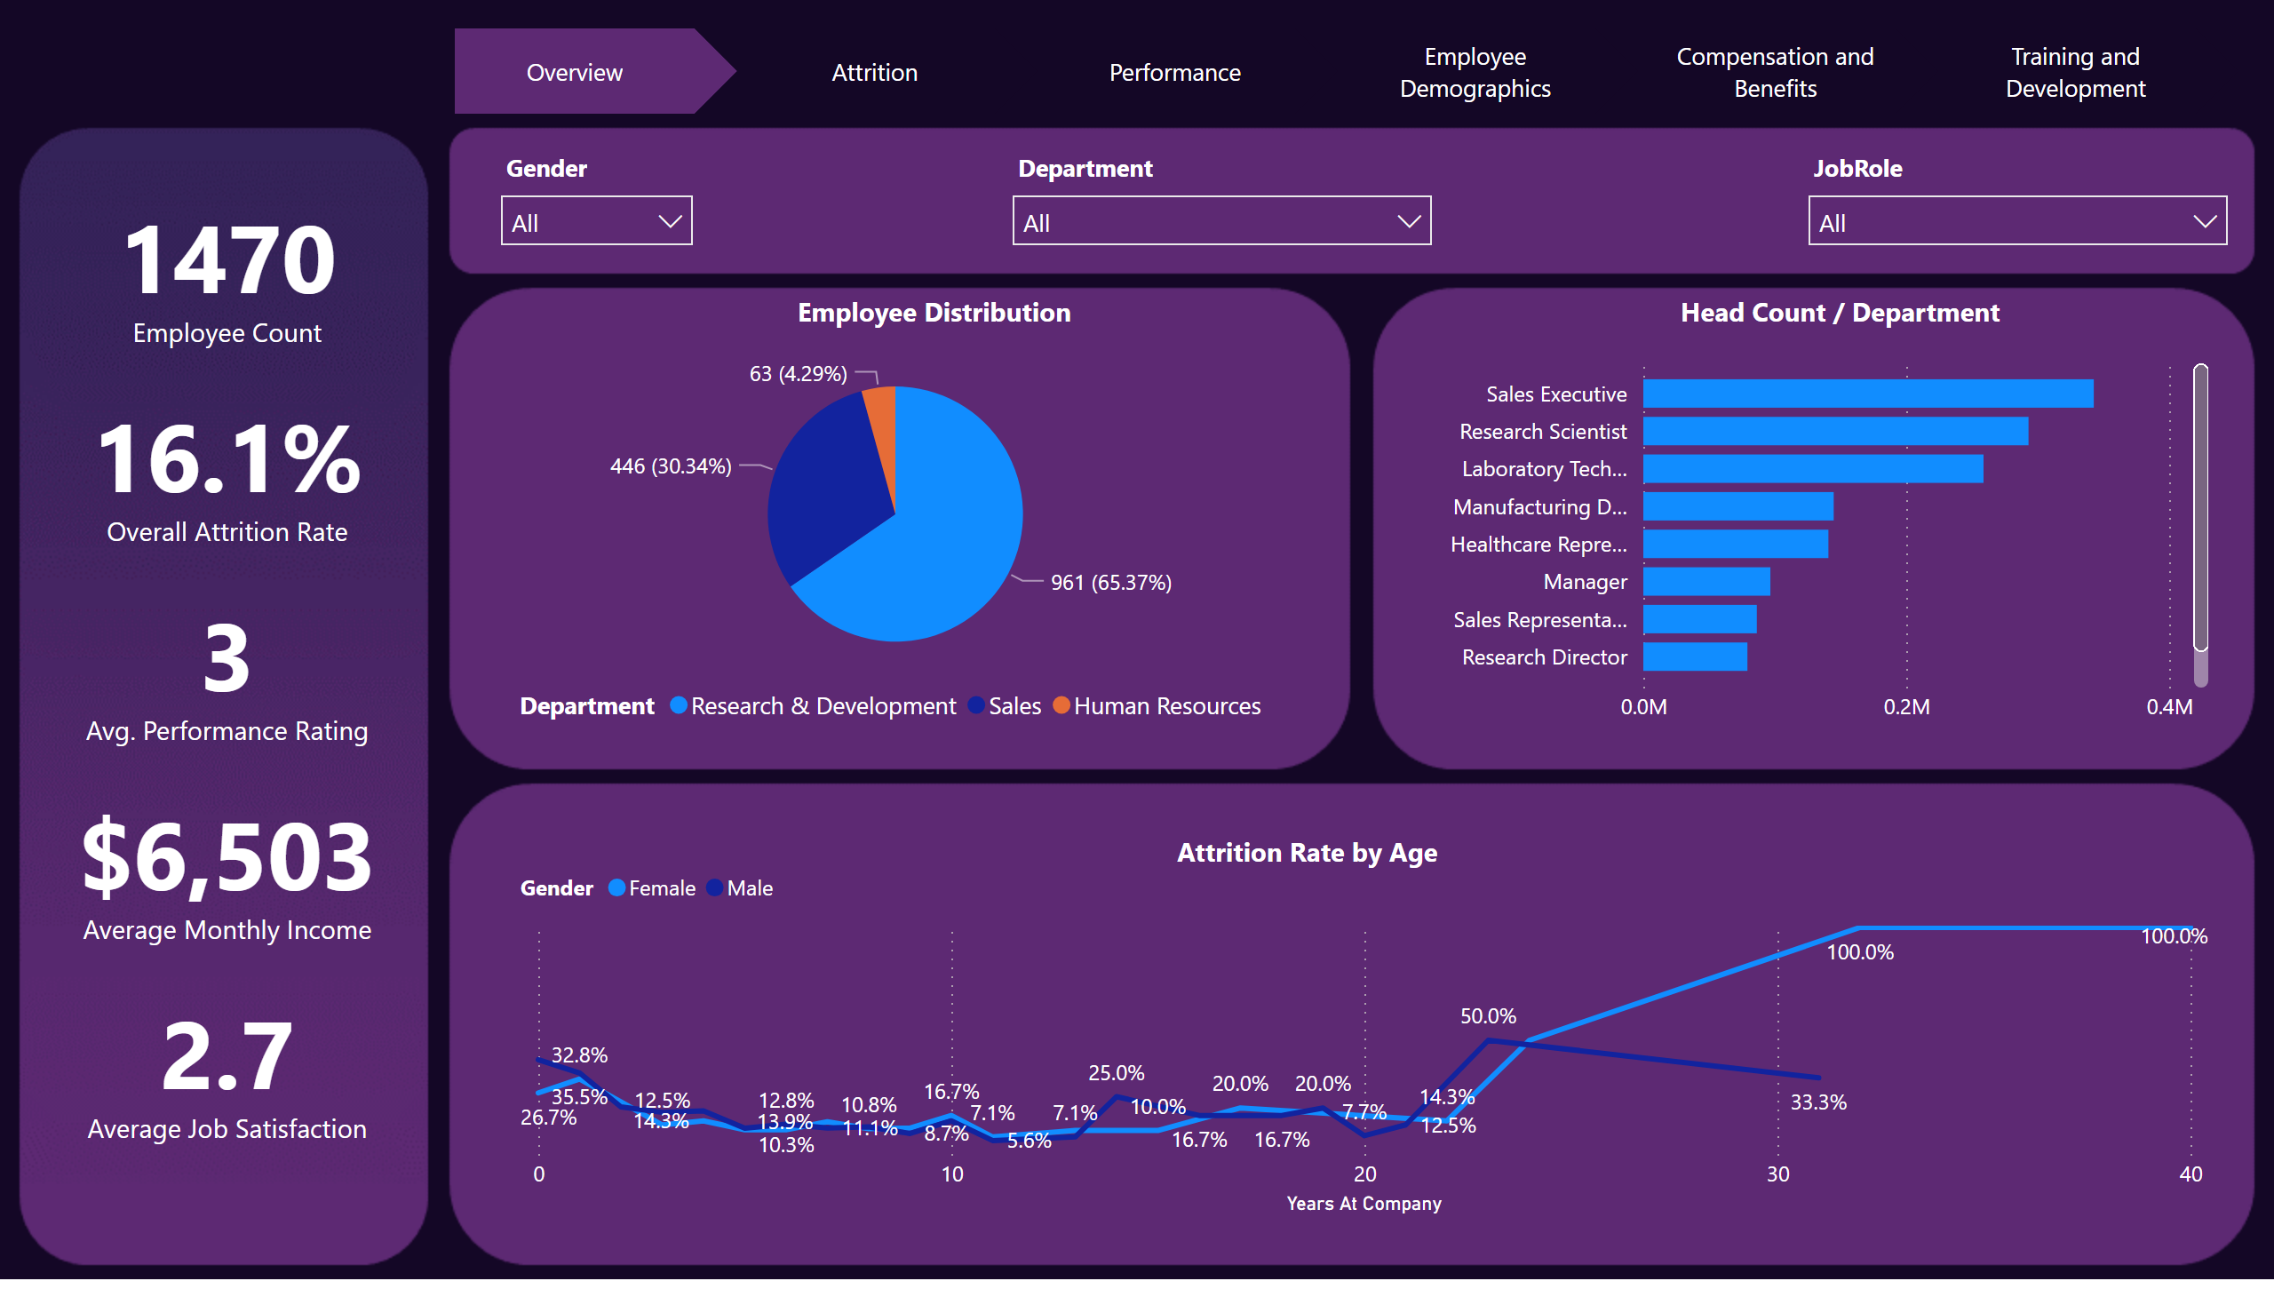
Overview
Notes:
card
No alt text provided
card
No alt text provided
card
No alt text provided
card
No alt text provided
pieChart
No alt text provided
clusteredBarChart
No alt text provided
lineChart
No alt text provided
slicer
No alt text provided
slicer
No alt text provided
slicer
No alt text provided
card
No alt text provided
pageNavigator
No alt text provided
textbox
No alt text provided
textbox
No alt text provided
textbox
No alt text provided

Slide 3
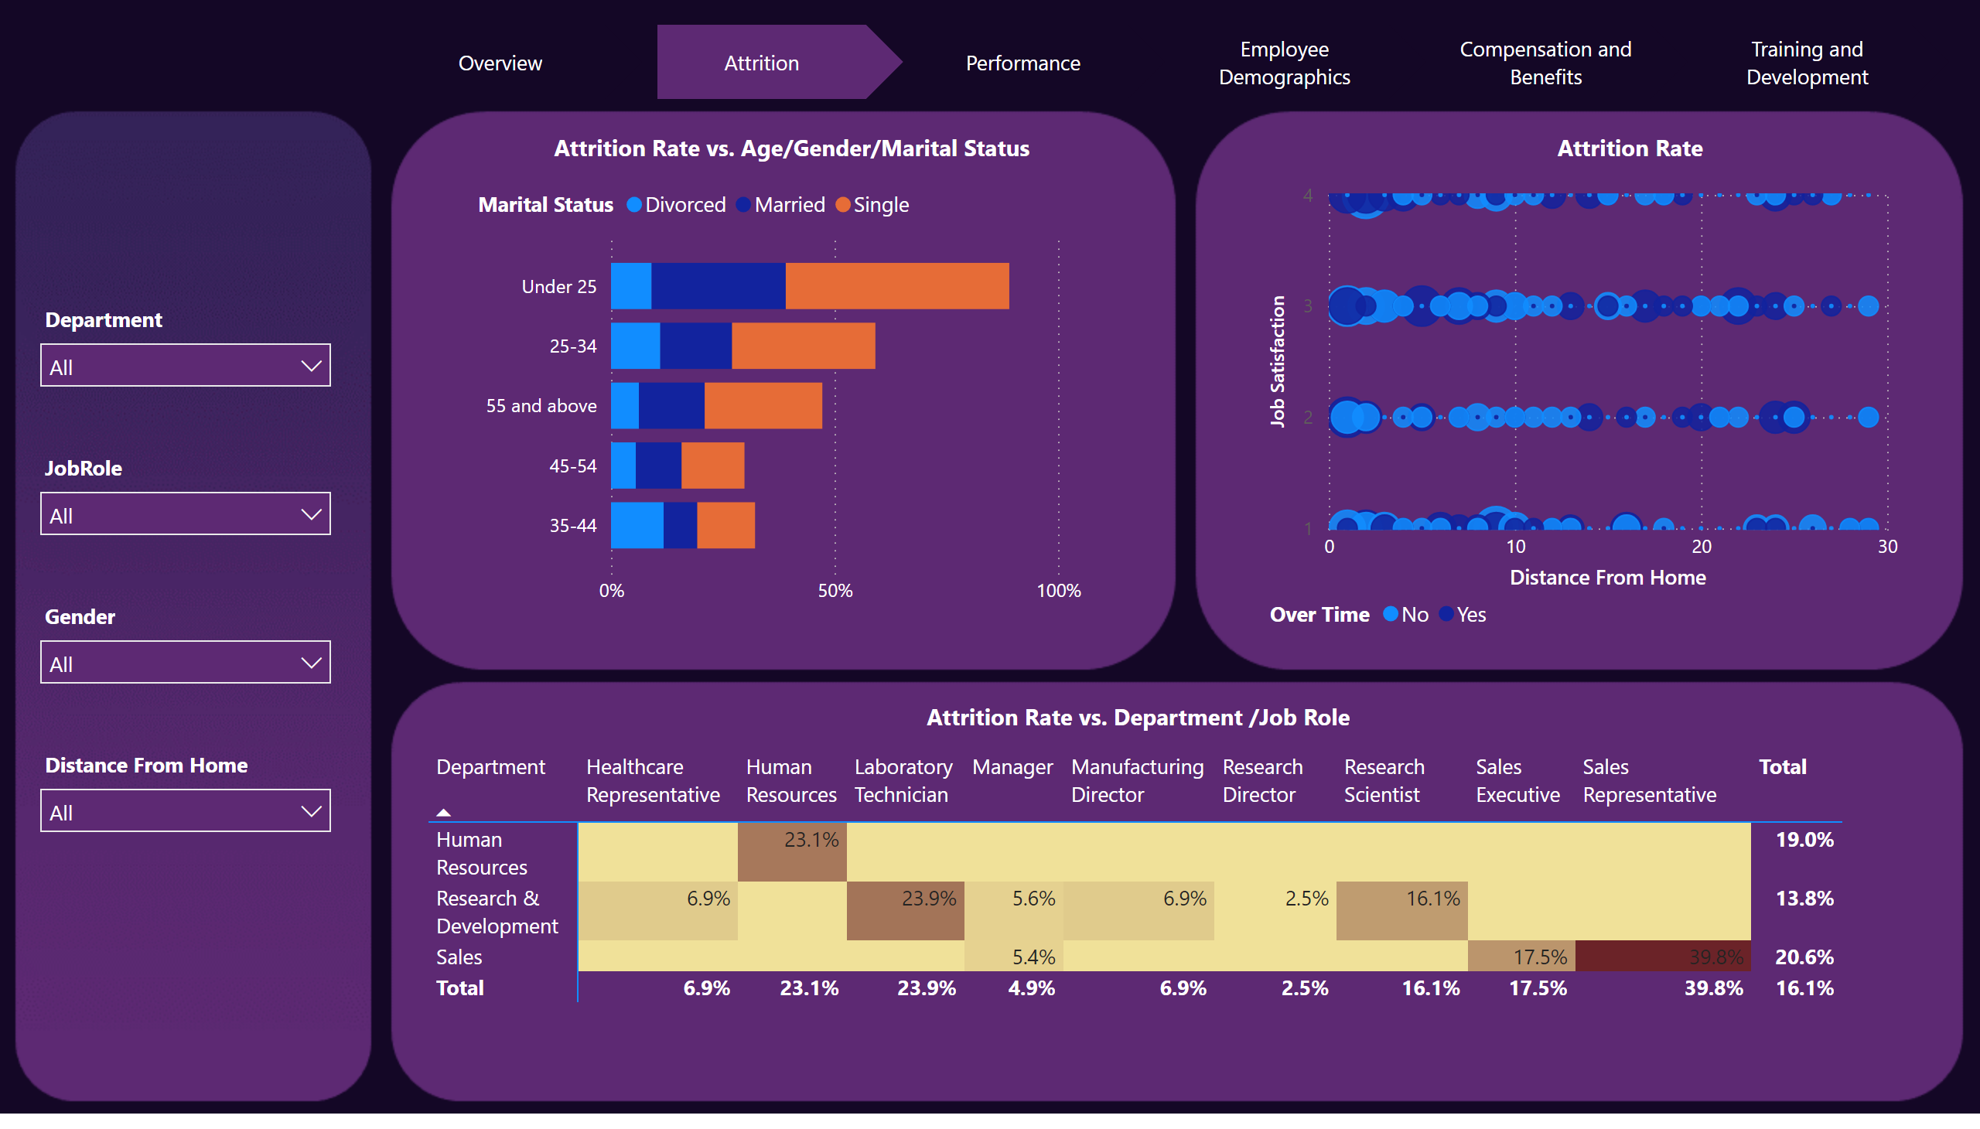
Attrition
Notes:
slicer
No alt text provided
slicer
No alt text provided
slicer
No alt text provided
slicer
No alt text provided
barChart
No alt text provided
pivotTable
No alt text provided
scatterChart
No alt text provided
pageNavigator
No alt text provided
textbox
No alt text provided
textbox
No alt text provided
textbox
No alt text provided

Slide 4
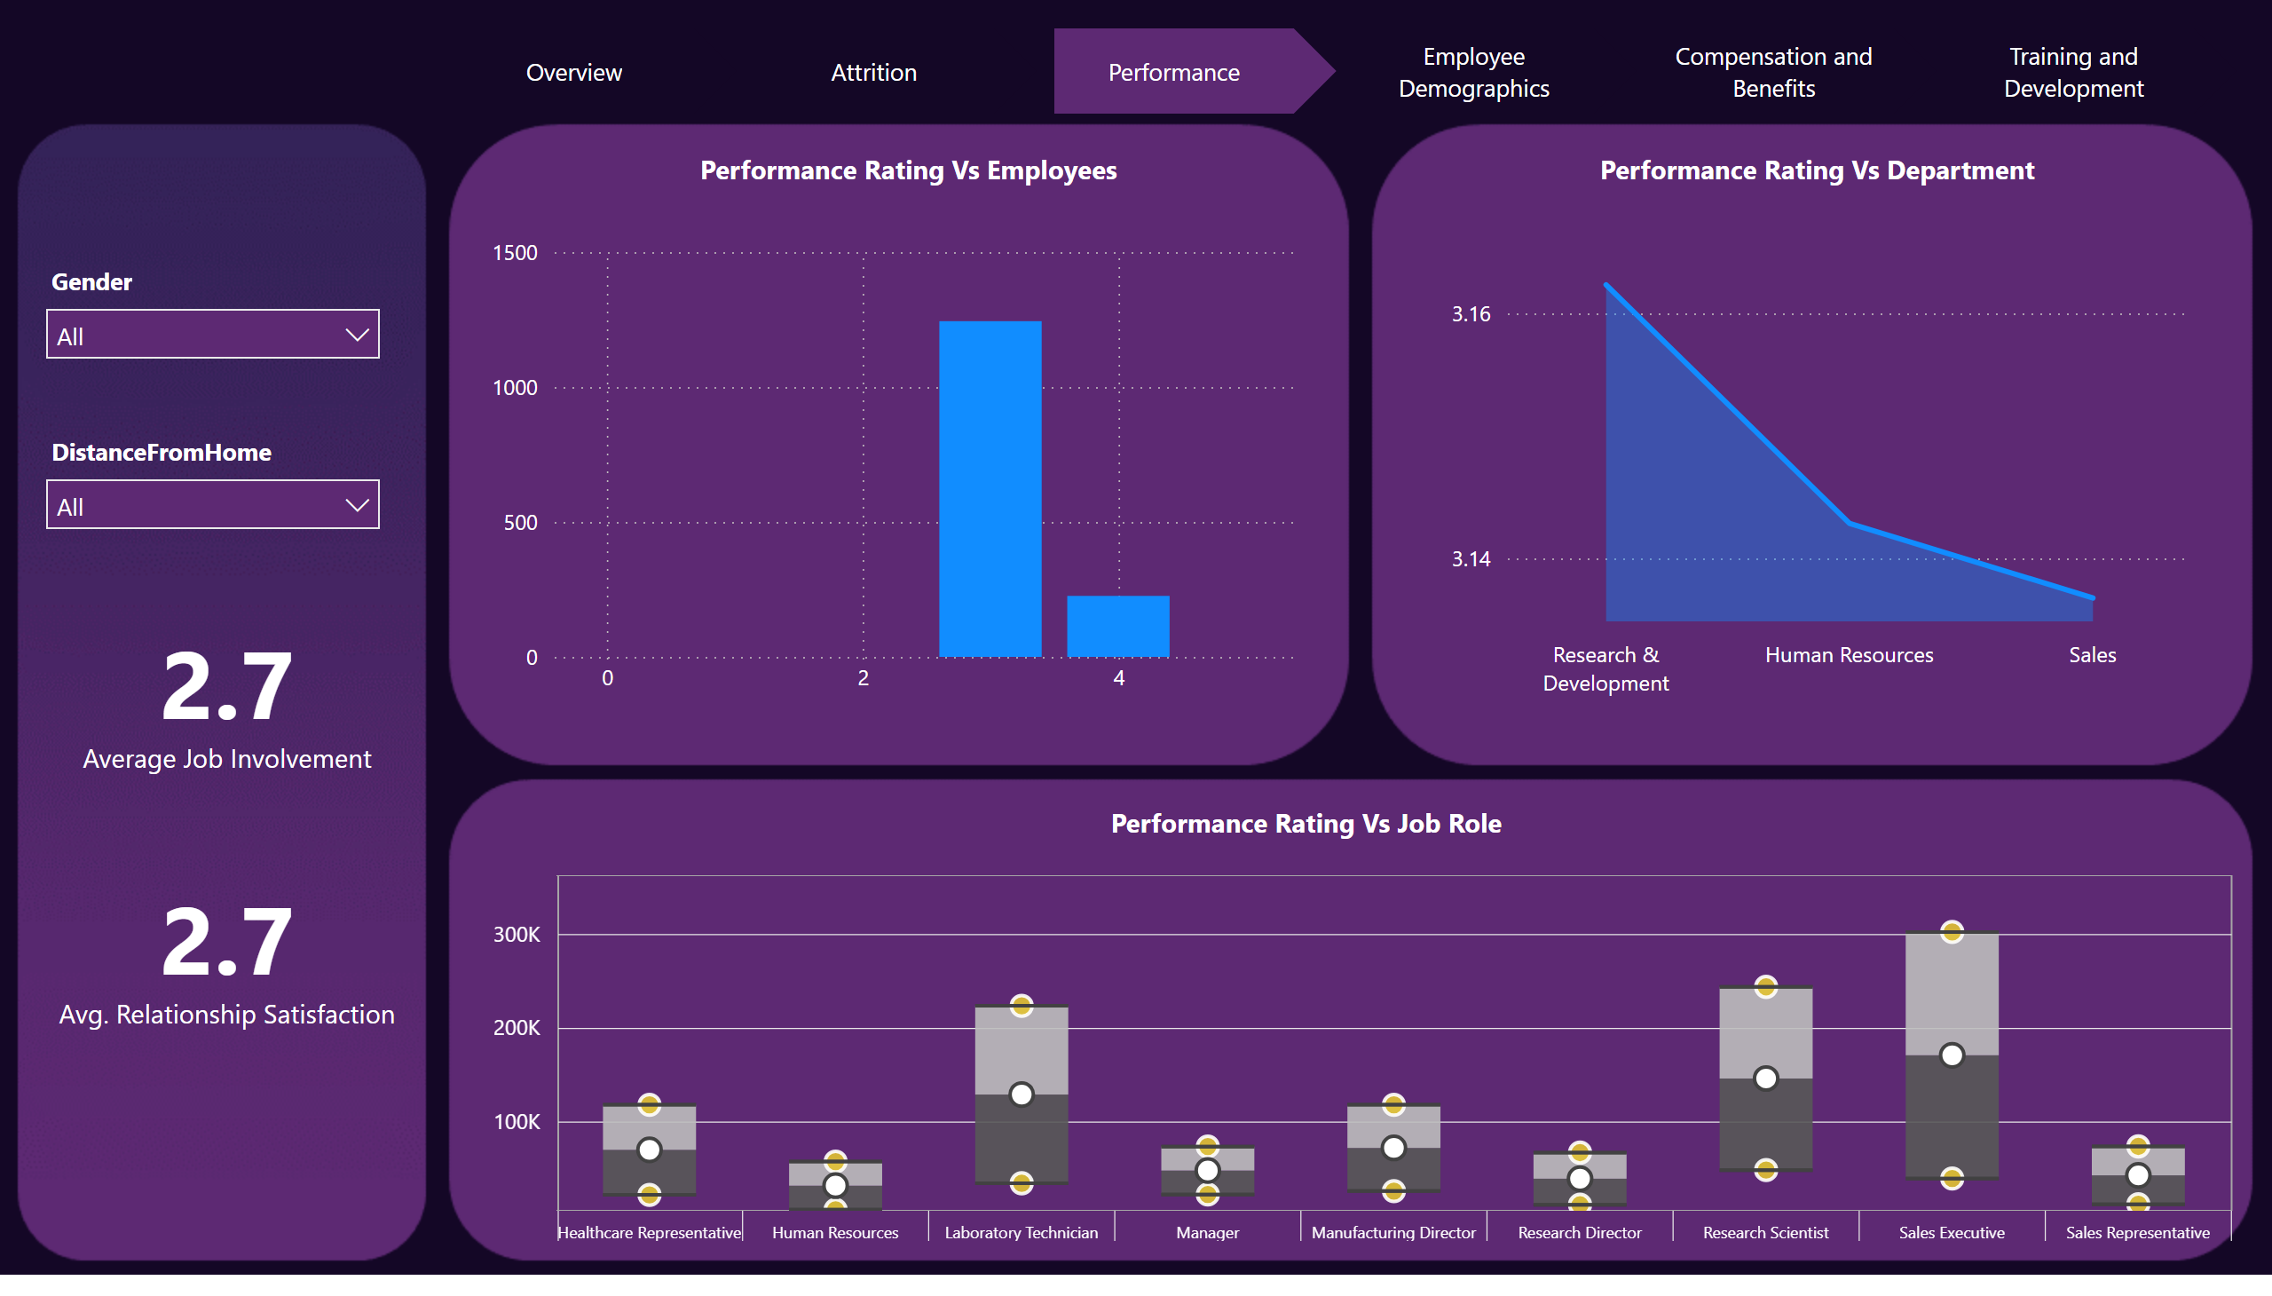
Performance
Notes:
slicer
No alt text provided
slicer
No alt text provided
stackedAreaChart
No alt text provided
columnChart
No alt text provided
BoxandWhiskerByMAQ1823AD39DT234AB532063E128AX
No alt text provided
card
No alt text provided
card
No alt text provided
pageNavigator
No alt text provided
textbox
No alt text provided
textbox
No alt text provided
textbox
No alt text provided

Slide 5
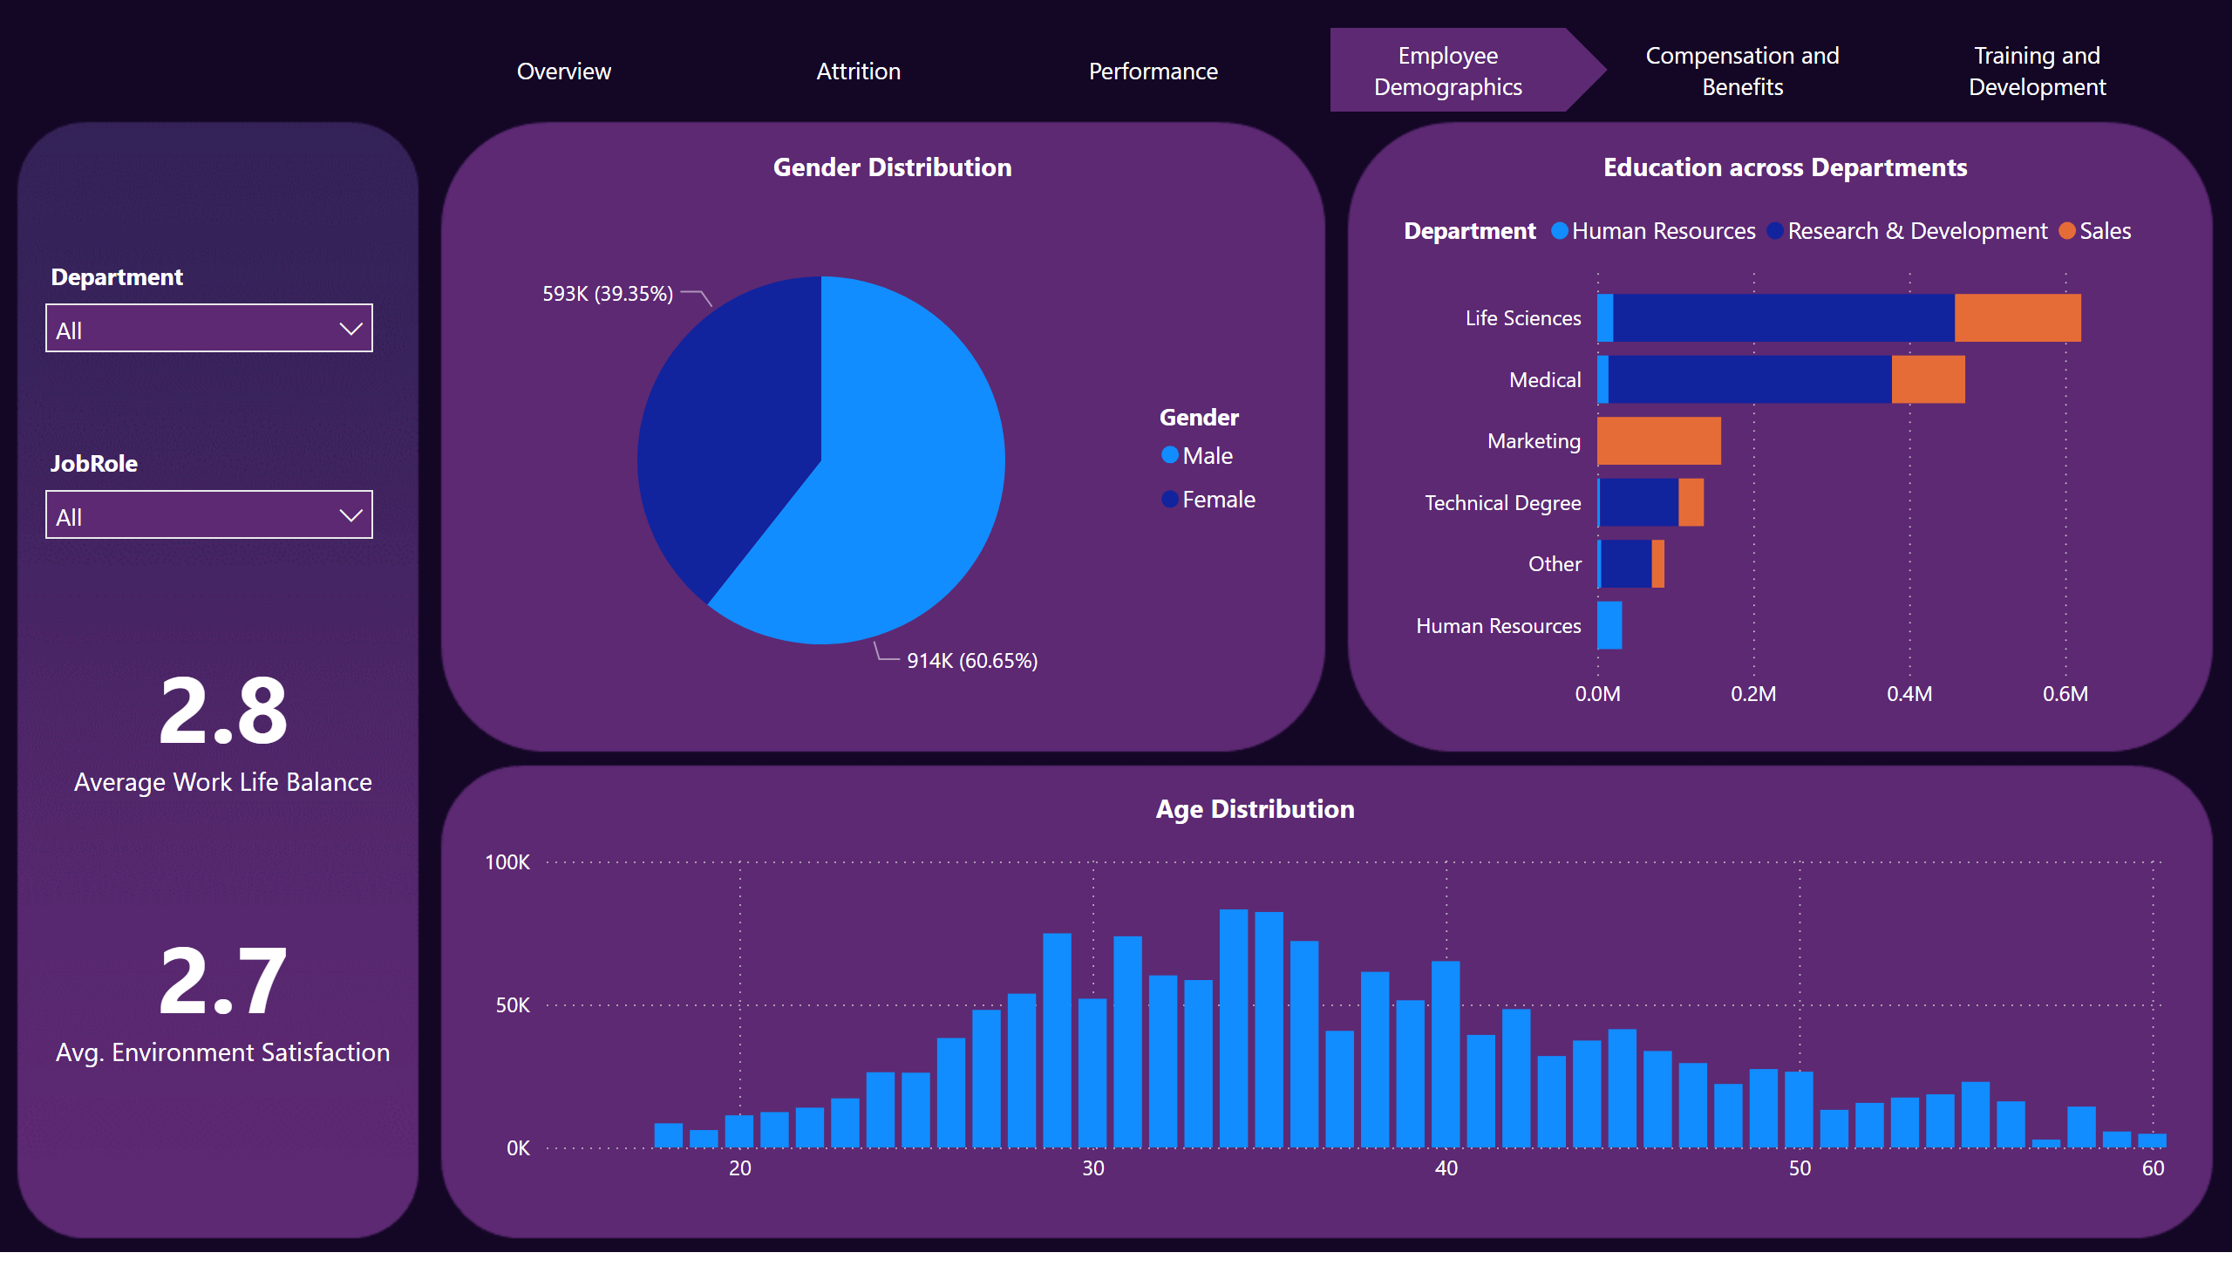
Employee Demographics
Notes:
slicer
No alt text provided
slicer
No alt text provided
pieChart
No alt text provided
columnChart
No alt text provided
barChart
No alt text provided
card
No alt text provided
card
No alt text provided
pageNavigator
No alt text provided
textbox
No alt text provided
textbox
No alt text provided
textbox
No alt text provided

Slide 6
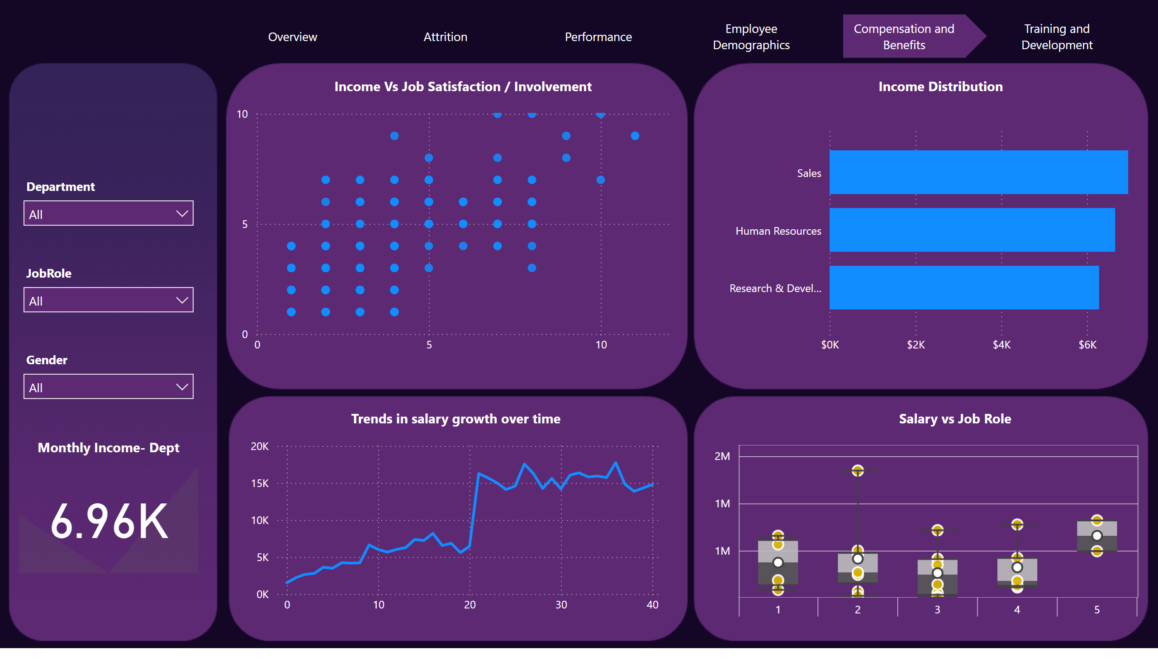
Compensation and Benefits
Notes:
BoxandWhiskerByMAQ1823AD39DT234AB532063E128AX
No alt text provided
scatterChart
No alt text provided
barChart
No alt text provided
lineChart
No alt text provided
slicer
No alt text provided
slicer
No alt text provided
slicer
No alt text provided
kpi
No alt text provided
pageNavigator
No alt text provided
textbox
No alt text provided
textbox
No alt text provided
textbox
No alt text provided
textbox
No alt text provided
textbox
No alt text provided

Slide 7
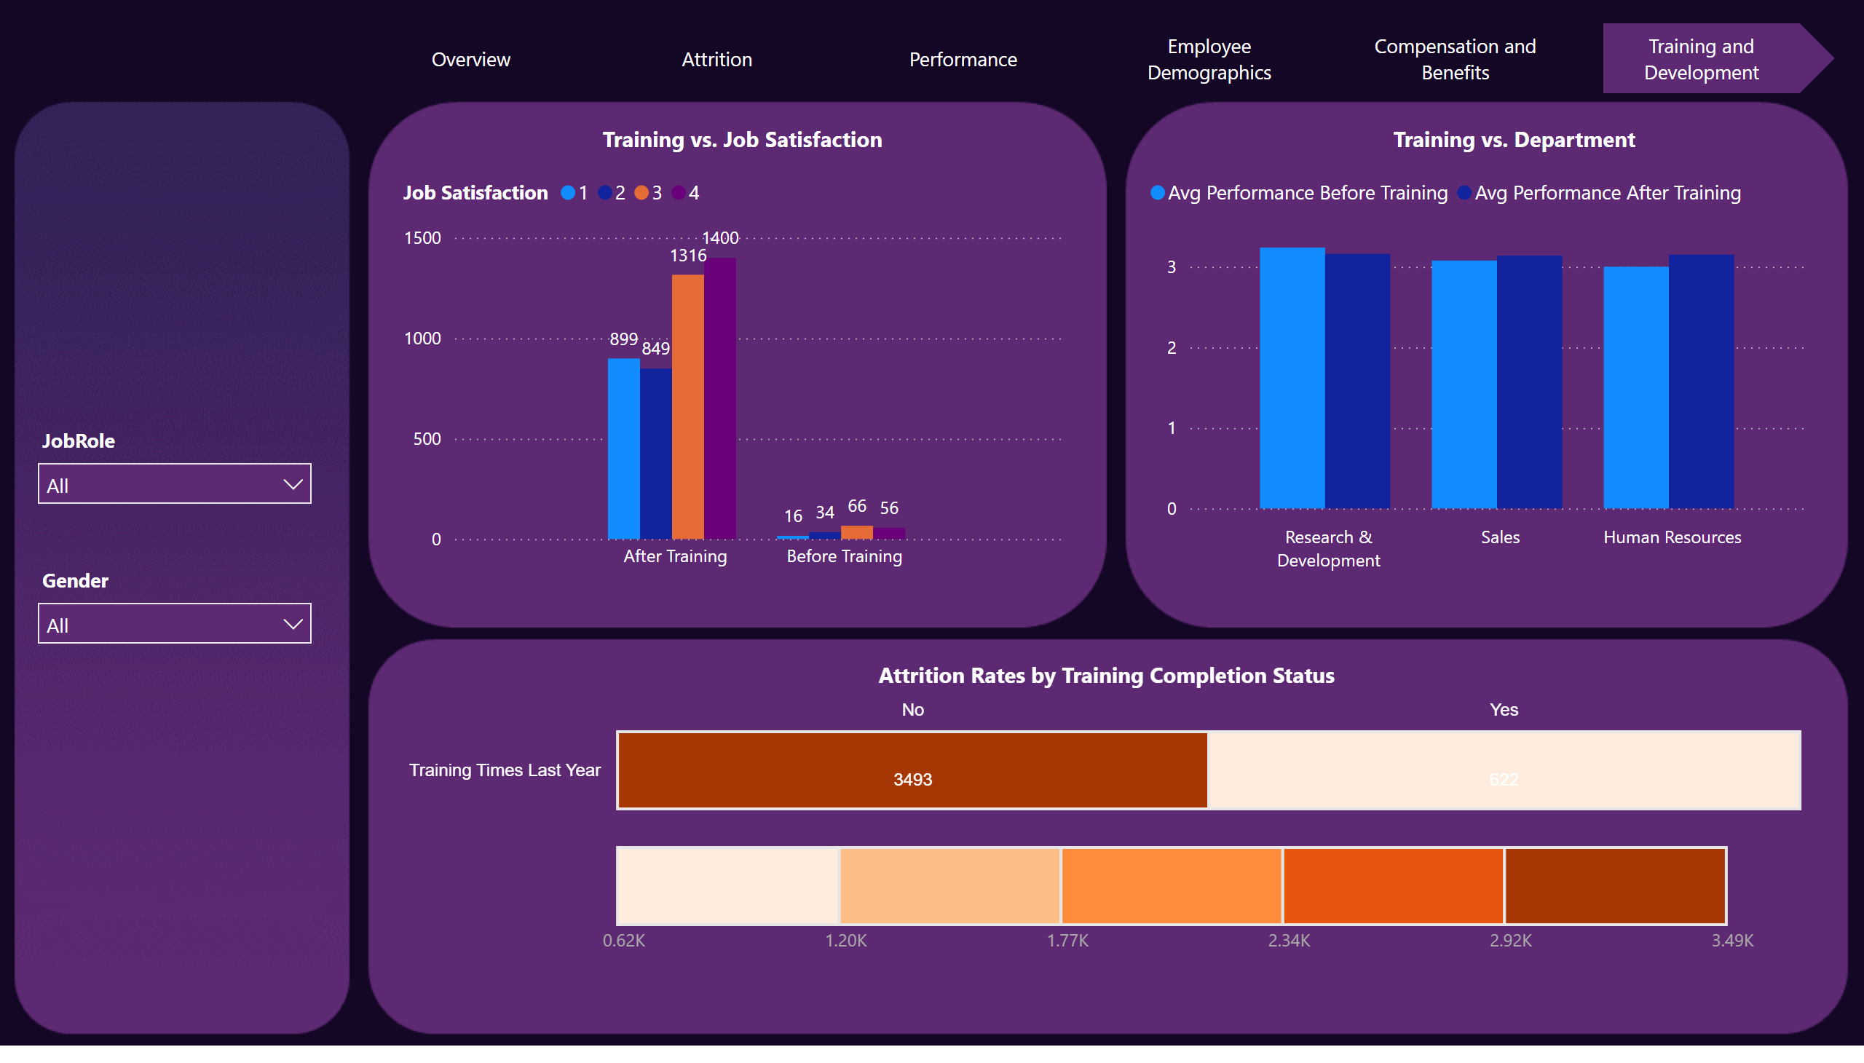
Training and Development
Notes:
slicer
No alt text provided
slicer
No alt text provided
TableHeatMap1443716069308
No alt text provided
clusteredColumnChart
No alt text provided
lineClusteredColumnComboChart
No alt text provided
pageNavigator
No alt text provided
textbox
No alt text provided
textbox
No alt text provided
textbox
No alt text provided

